Slide 1


SIRAH OF THE PROPHET
A BRIEF TIMELINE OF THE LIFE OF THE NOBLE PROPHET

Slide 2
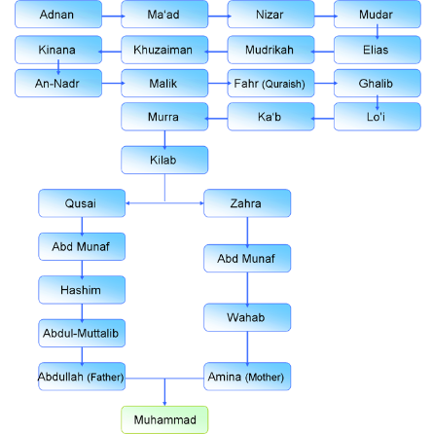
Birth
Born: Rabi’ul Awwal, ‘Year of the Elephant’
Mother: Aminah
Father: Abdullah; Passed away before the Prophet’s birth
Tribe: Quraysh
Birthplace: Makkah

Slide 3
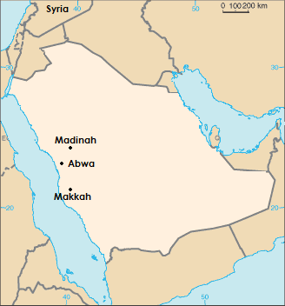
Youth
Foster Mother:
Halimah Sa’diyyah
Years spent with Halimah: 4
Mother Aminah passes away in Abwa
Age at time of death: 6
Grandfather:
‘Abdul Muttalib
Age at time of death: 8
Uncle: Abu Talib
Age 12 travelled to Syria with Abu Talib

Slide 4




Khadijah
Worked honestly for Khadija in Syria and watched by her friend Maysarah
Proposal from Khadijah
Khadija previously widowed twice
Prophet accepts proposal
Prophet ’s Age: 25
Khadija’s Age: 40

Slide 5
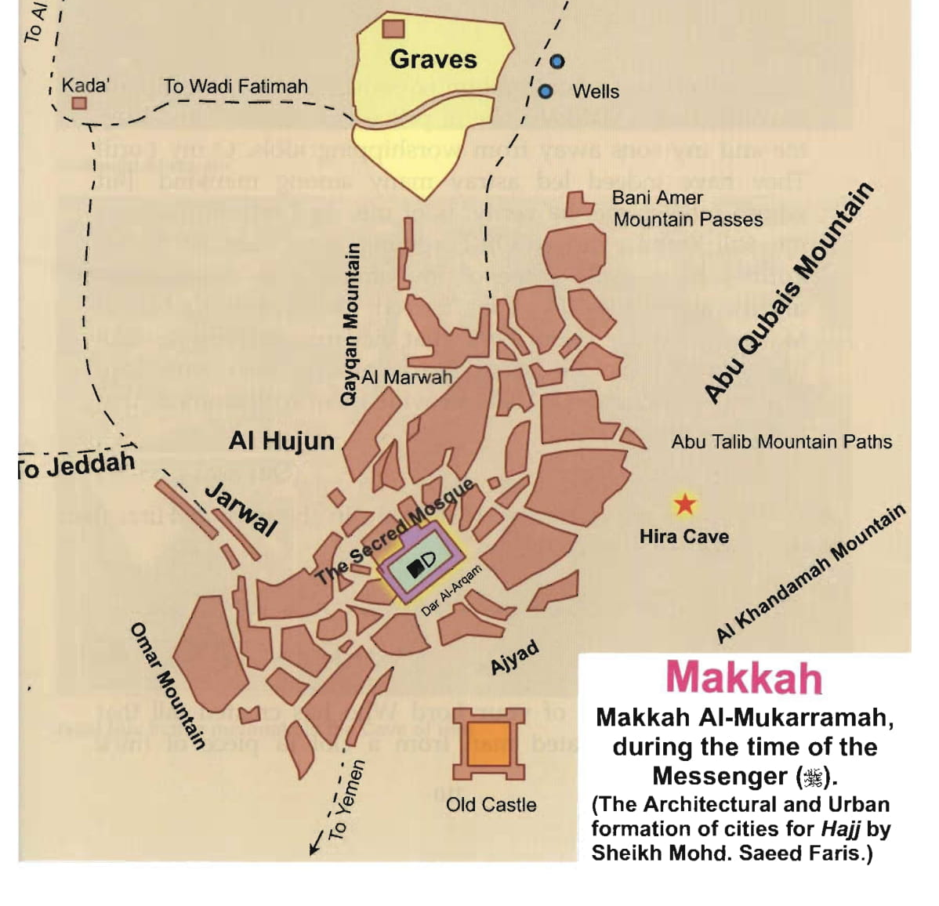
First Revelation
Prior signs:
  Dreams which came true
Age: 40
Location: Cave of Hira
Brought by Angel Jibra’il
Verses: Surah 96, Ayah 1-5

Slide 6


First Believers
Waraqah – Christian Cousin of Khadija
First Person to Accept Islam: Khadija – Wife
First Believers:
Zayd ibn Harith – Freed Slave/ Adopted Son
Ali ibn Abi Talib - Cousin
Abu Bakr ibn Abi Quhafah - Friend

Slide 7
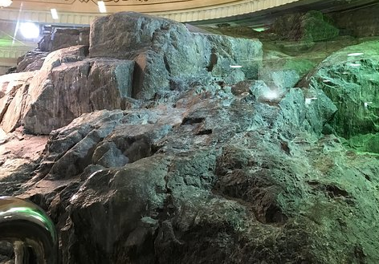
Invitation to Islam
“And warn the nearest people of your clan” (Qur’n 26:214)
Invited relations from Banu Hashim
Sermon on Mount Safa
Many people & the leaders of the Quraysh gathered
Abu Lahab cursed the Prophet openly

Slide 8
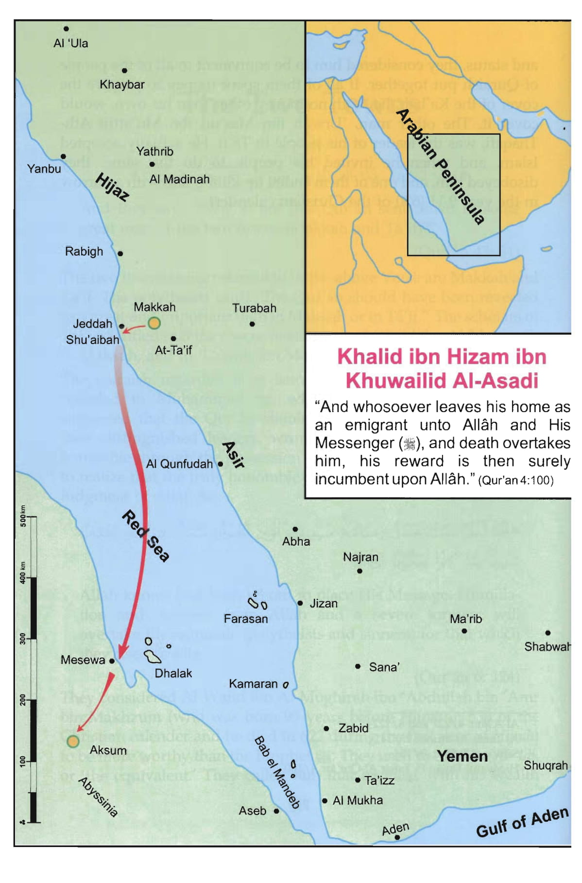
Migration to Abysinnia
1st Migration:
  12 men, 4 women
  Middle of the 5th Year of Prophethood
2nd Migration:
  83 men, 18 women
  Followed by the Quraysh
Najashi – Christian King of Abyssinia: Allowed the Muslims to stay after hearing the message of Islam from Jafar

Slide 9
Two Great Warriors
Hamza ibn Abdul Muttalib, Prophet’s uncle accepts Islam after rudeness of Abu Jahl to the Prophet ( )
Umar ibn al-Khattab accepts Islam after reciting Surah Ta Ha in the house of his sister

Slide 10
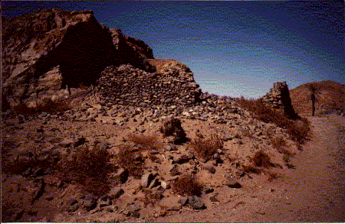
The Boycott
7th Year of Prophethood
Boycott on Banu Hashim and Banu Muttalib
Settled in Shi’b Abi Talib
No one could speak, mix, buy, sell or marry within the two tribes
Lasted 3 years

Slide 11

The Year of Sadness
Six months after the boycott
Prophet’s loving uncle Abu Talib passes away as a disbeliever
Few months later
Beloved wife Khadija passes away aged 65

Slide 12
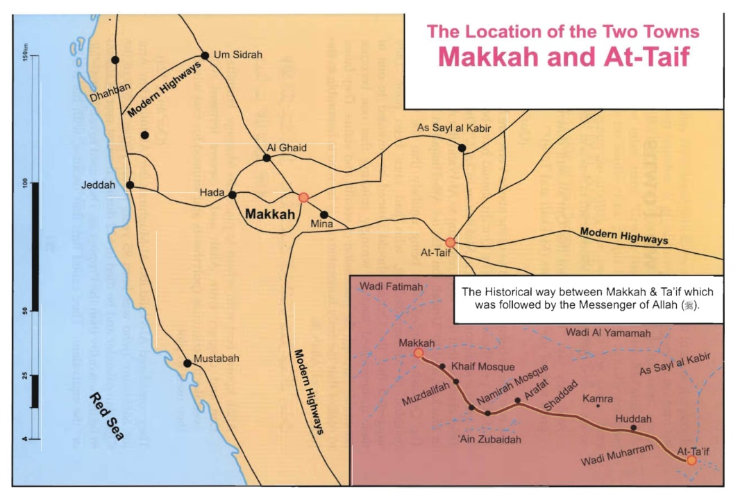
Journey to Taif
Take the message of Islam out of Makkah
Seeking haven away from Quraysh
Stayed 10 days in Taif
Ignored the Prophet’s message and pelted him with stones
Prophet returned to Makkah

Slide 13
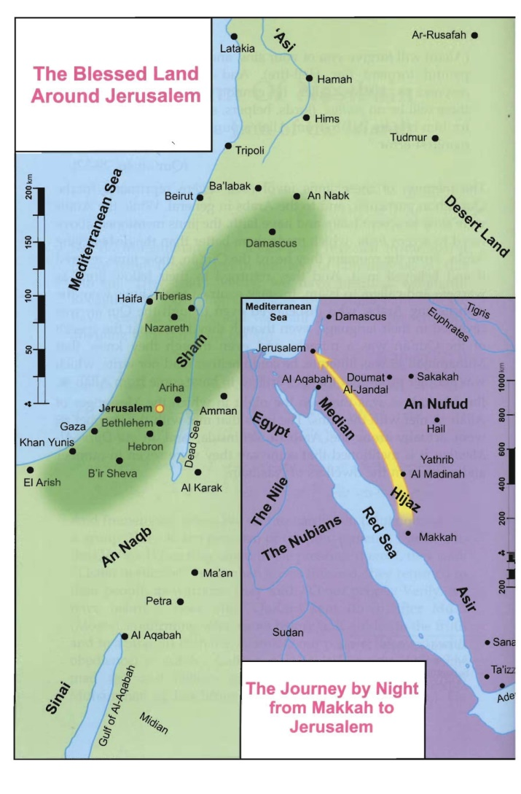
Al-Isra & Al-Miraj
Al-Isra (the Night Journey) – Prophet’s journey from Makkah to Bayt al-Maqdis in Jerusalem, in one night
Al-Miraj (the Ascent)– Prophet’s journey from Bayt al-Maqdis to the Heavens in which Allah gifted Salah
Buraq – A beautiful white creature from the heavens that the Prophet used as transport during Al-Isra and Al-Miraj
Sidrah al-Muntaha – the Lote Tree of the Furthest Region

Slide 14
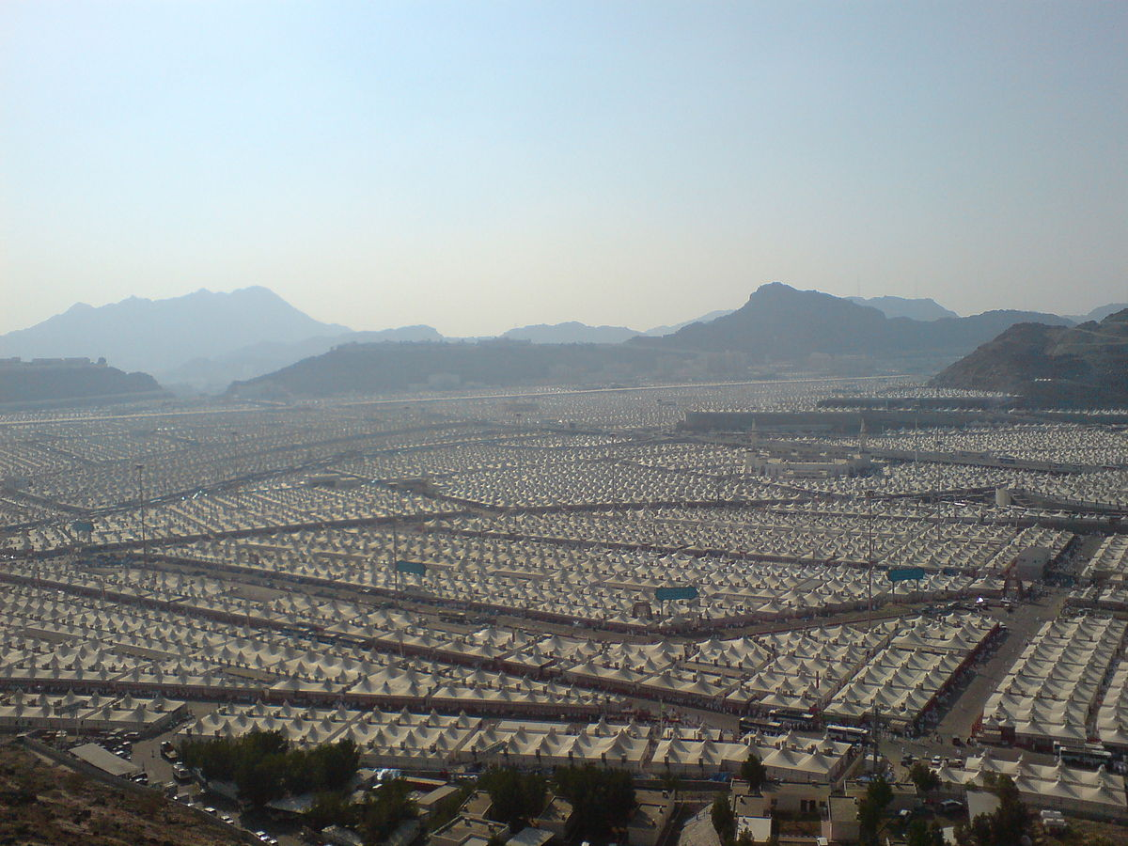
First Pledge of Aqabah
12th Year of Prophethood
12 people from Yathrib (Madinah) pledged to believe in Allah and the Prophet
In Aqabah near Mina during pilgrimage season
Prophet sent Mus’ab ibn Umayr back with them to be their teacher

Slide 15
Second Pledge of Aqabah
13th Year of Prophethood
70 new muslims
Returned with Musab ibn Umayr
Near place of the 1st pledge
12 people to represent matters of the pledge

Slide 16
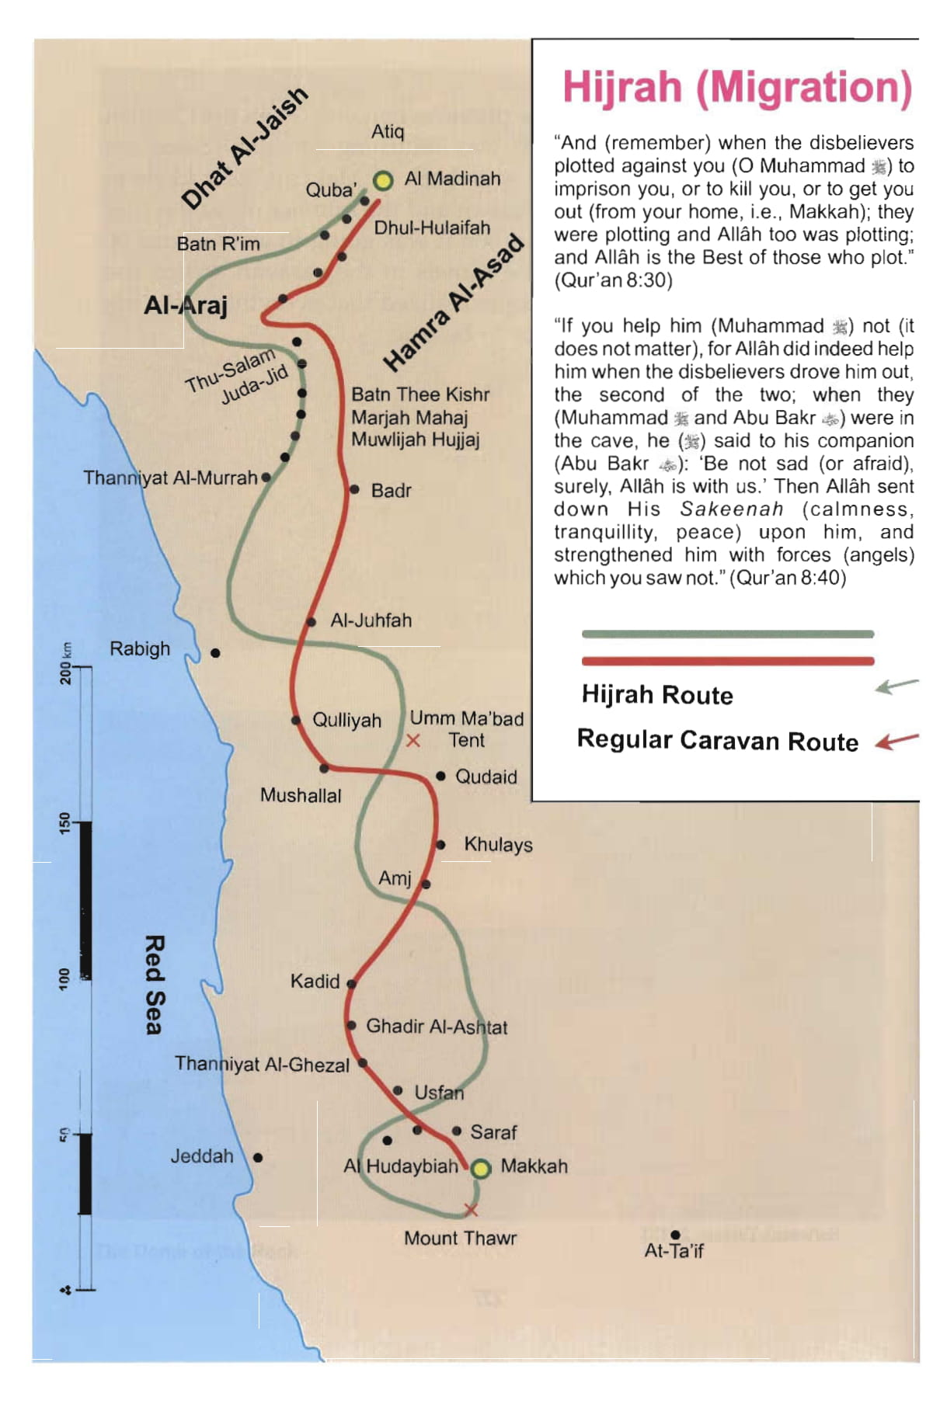
Hijrah
Announced after the 2nd Pledge
Allah saved the Prophet from a plot to kill him
Allah protected the Prophet and Abu Bakr with a pigeon and spider in the Cave of Thawr
Reached Quba on 8th of Rabi al-Awwal
Reached Madinah on Friday 12th Rabi al-Awwal

Slide 17
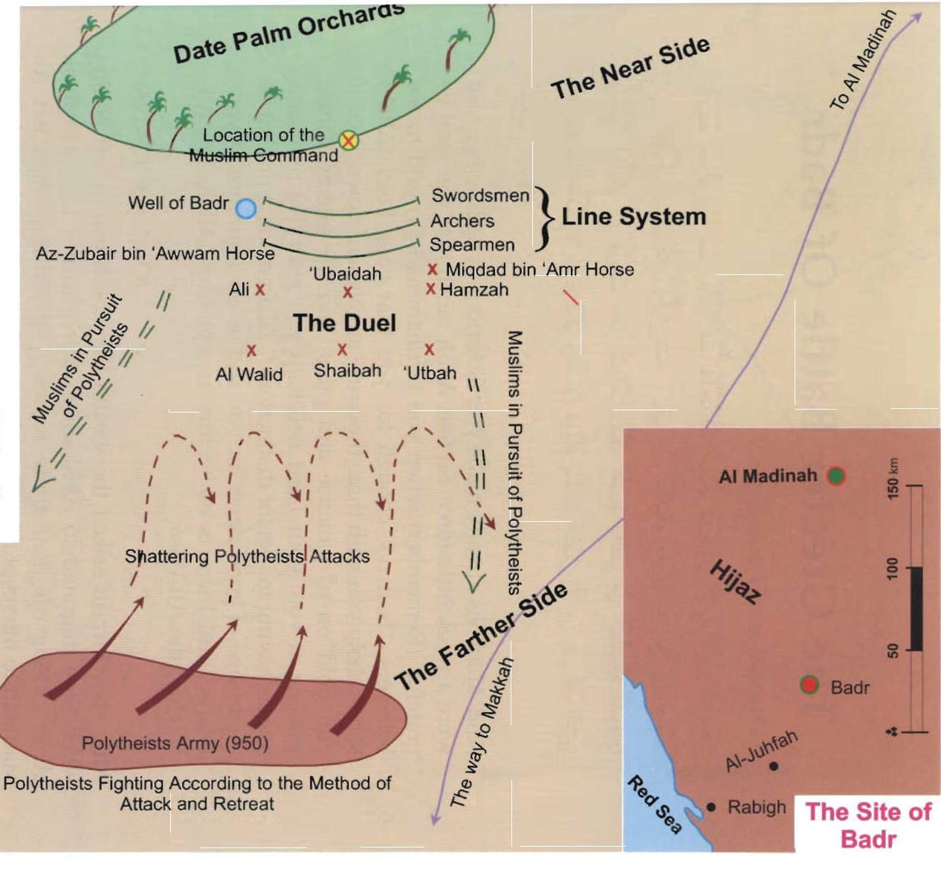
Battle of Badr
17th of Ramadan 2AH
313 Muslims
1000 disbelievers under Abu Jahal
Victory for the Muslims
Casualties:
13 Martyrs
70 Disbelievers

Slide 18
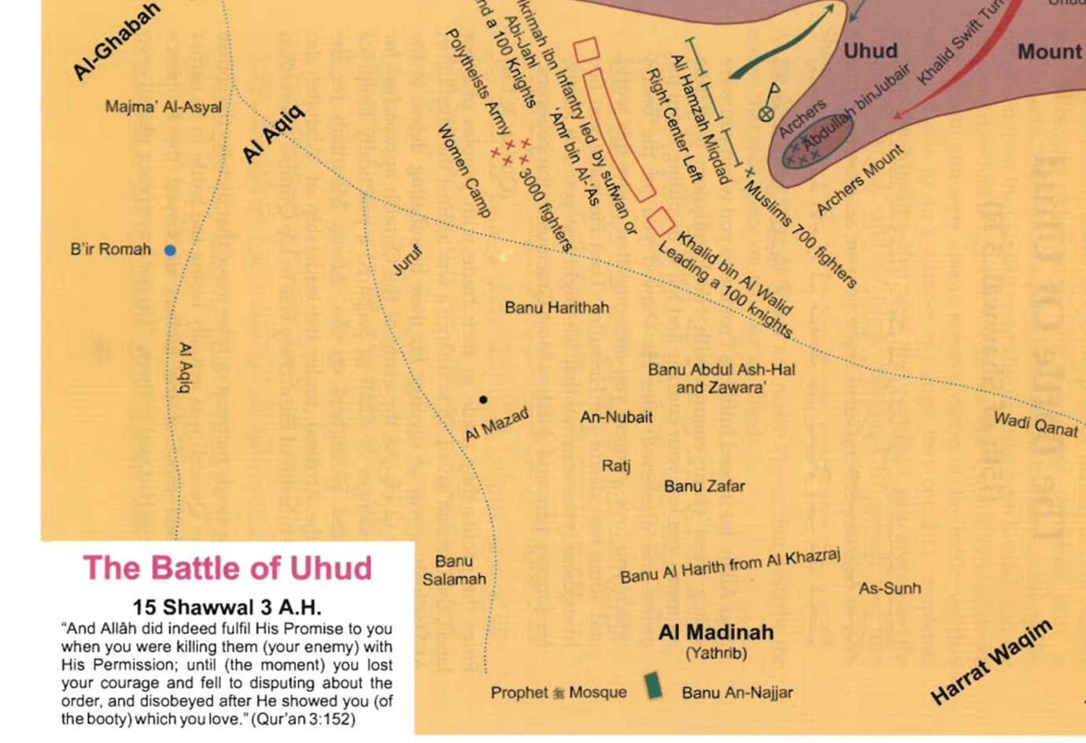
Battle of Uhud
Shawwal 3AH
Left Madinah with 1000 Muslims
300 hypocrites left the army
700 men left in Muslim army
3000 Disbelievers
50 archers on a small hill
Casualties:
  70 martyrs
  Few Disbelievers
  The Prophet and many sahaba injured

Slide 19
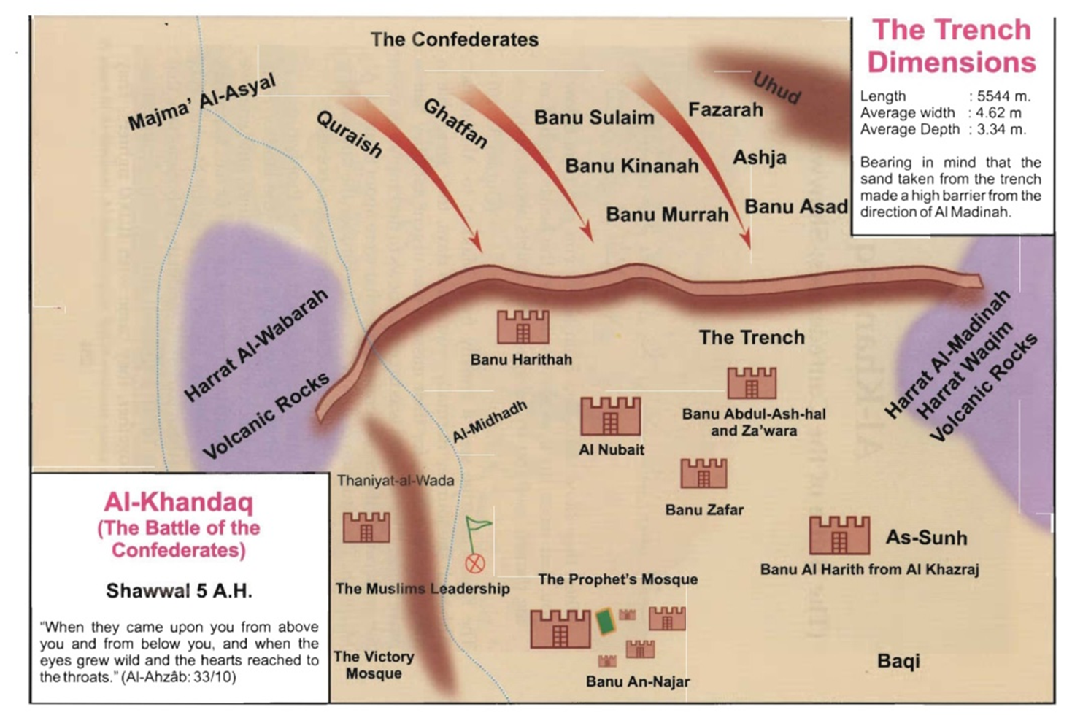

Battle of Ahzab
Dhul Qa’dah 5AH
Muslims of Madinah vs 10,000 Disbelievers (4,000 Makkans + Ghatfan Tribe + Banu Sulaym + Banu Qurayzah)
Salman al-Farsi suggests trenches around the city
Disbelievers laid siege for 27 days
Allah sent a storm that made the disbelieving flee

Slide 20
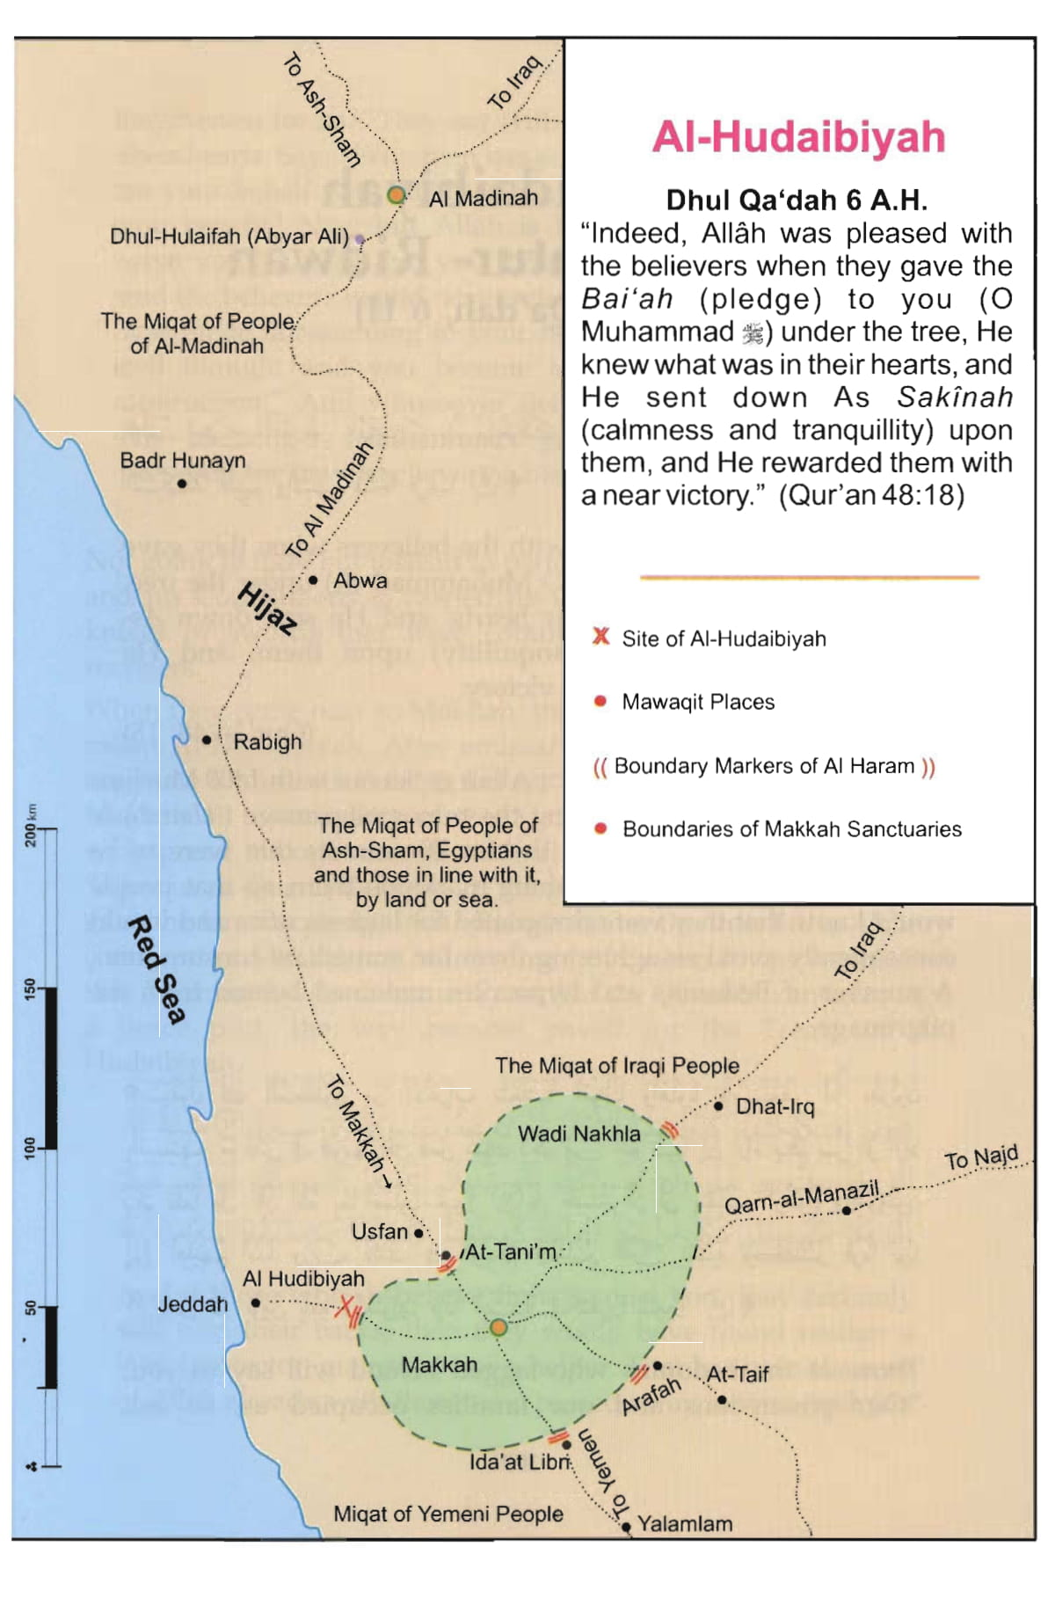
Treaty of Hudaybiyah
Dhul-Qa’dah 6AH
Quraysh representative: Suhayl ibn Amr
Terms:
  Muslims return to Madinah and perform ‘Umrah next year
  10 year peace treaty
  Any alliances between tribes allowed
  If any Muslim of Makkah was to go to Madina he must be returned and if any person was to go to Makkah he would not be returned to Madinah
Bay’ah ar-Ridwan
  The promise to avenge Uthman when the Muslims thought he had been murdered whilst negotiating the Treaty of Hudaybiyah with the Quraysh

Slide 21
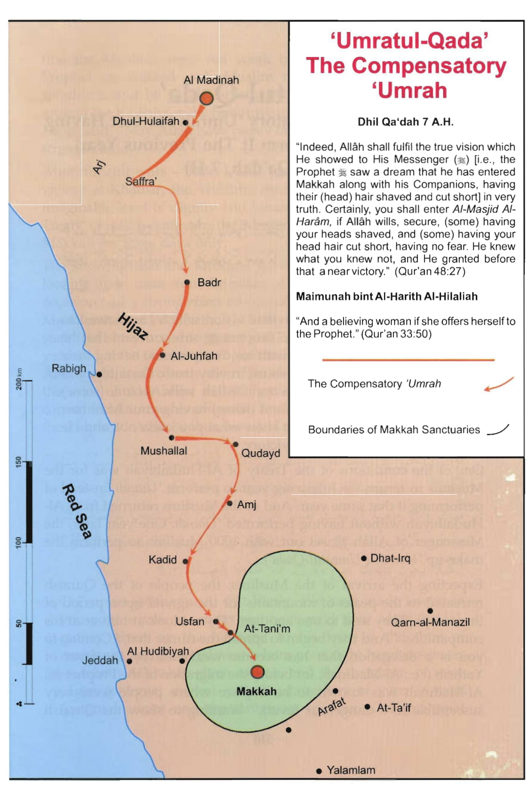
Umrah al-Qada
End of 7AH
Umrah agreed on in the Treaty of Hudaybiyah
Prophet Muhammad stayed in Makkah for 3 days
Disbelievers vacated Makkah

Slide 22
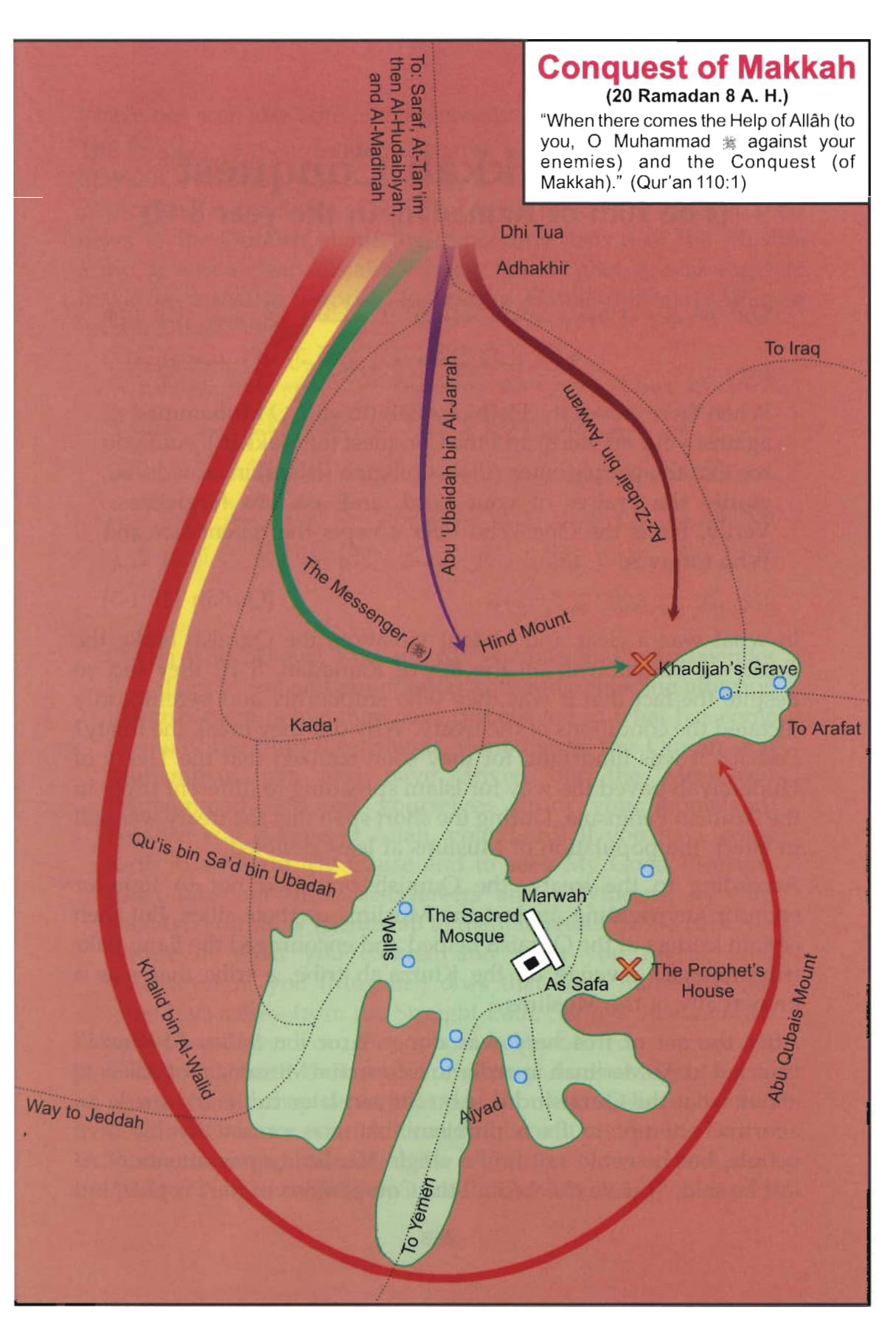
Conquest of Makkah
Quraysh broke the Treaty of Hudaybiyah
Prophet leaves Madinah with 10,000 soldiers
Camped at Marruz Zaahran
Abu Sufyaan accepts Islam
Muslim army enter Makkah on Tuesday 17th Ramadan 8AH

Slide 23
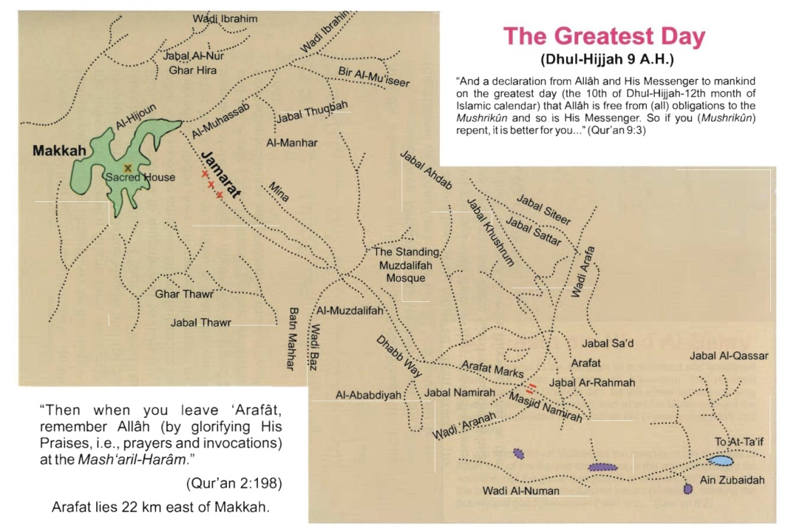
Farewell Pilgrimage
10AH
Left Madina: the Saturday of the last four days of Dhul Qa’dah
Arrived in Makkah: Sunday morning 4th Dhul Hijjah
124,000 companions at Arafah during Hajj

Slide 24


Passing Away of the Prophet
Prophet fell ill at the end of Safar 11AH
Passed away:
Monday 12th
Rabi’al-Awwal
11AH
Abu Bakr addressed Sahabah and explained that the Prophet was human and that prophets before him have passed

